Slide 1
Art Authentication
Cássio R. F. Riedo & Guilherme A. Fôlego

Slide 2
History
Experts
Ultraviolet fluorescence
Infrared reflectography
X-radiography
Paint sampling
Canvas weave count

Slide 3
Some Works
Art authentication is based on signatures, provenance (the documentary record of ownership), chemical studies of media, material studies of support, preparation, fingerprints, and traditional connoisseurship is not always definitive. Any additional informative objective test could thus be quite valuable.
Biro (2006), in “Forensics and Microscopy in Authenticating Works of Art” says “so many major masterpieces hanging in museums have little provenance”.
    Among the most important techniques are the various methods of imaging from x-ray to ultraviolet, to visible light, to infrared. Materials and used techniques based on pigments and working methods can be considered as fingerprinting)
X-ray analysis (chemical approach: non-distruttive analysis – hidden paintings)
“L’arte di analizzare l’arte: la battaglia di Anghiari, Van Gogh e Goya” (Curceanu ) − 2013
“The Mona Lisa identification: evidence from a computer analysis” (Schwartz) – 1988
“Van Gogh’s Painting Grounds: Quantitative Determination of Bulking Agents (Extenders) Using SEM/EDX” (Haswell et al.) – 2006 [Error: 10% or better]

Slide 4
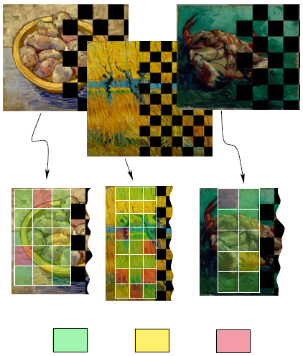
Some Works
“Authentication of Free Hand Drawings by Pattern Recognition Methods” (Kroner & Lattner) − 1998
  Proof of authenticity is one of the major problems in history of arts especially with respect to unsigned works of famous artists.
  Dataset of 41 images (19 from Delacroix) with correct classification for about 87% of the drawings
  Features are calculated rapidly directly on the scanned drawings without any preprocessing
Rendering algorithm
“A Novel Color Transfer Algorithm for Impressionistic Paintings” (Lee et al.) − 2012
  An algorithm for impressionism, primarily focusing on paintings by van Gogh, to enhance the simulation of stroke color

Slide 5
Some Works
Analysis of colors
Digitalization allows the introduction of various numeric expressions of purely qualitative characteristics. Analysis is based on statistics and descriptive summaries of the obtained numeric information.
“Discovering the Visual Signature of Painters” (Herik & Postma) − 2000
  Analysis of lighting, brush strokes, marks, craquelure and composition
  “Computer analysis of Van Gogh’s complementary colours” (Berezhnoy et al.) − 2006
  New method called MECOCO - Dataset of 145 digitized and color-calibrated oil-on-canvas paintings
  “Similarity Analysis of Digitized Paintings” (Ohmi & Awata) − 2008
  Color and luminance expression of artistic paintings is investigated by a digital vectors, scope and waveform
  “Analysis of the distributions of color characteristics in art painting images” (Ivanova et al.) − 2008
  The analysis includes exploration of hue, saturation and luminance. the indexing is based on color characteristics.
  The image indexing features are divided into the following three groups: Canvas, Color, Edge features.
  The testing set comprises the works of Rembrandt, Van Gogh, Picasso, Magritte, and Dali.
  The color characteristics in the art are different and in the most cases they represent the artist's style, the scent of his/her time, the movement, the influence of the `foreign" art.

Slide 6
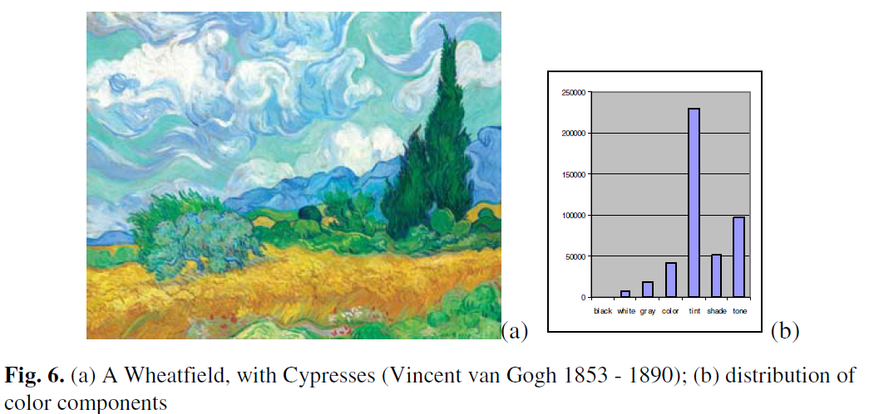
Some Works
A new science of visual style metrics appears: Stylometric analysis of art –
The use of computational tools from image analysis and machine learning
“Indexing and Retrieving Oil Paintings Using Style Information” (Yan & Jin) – 2005 [1503 paintings - different color retrieval schemes because there are differences among the light, paint, and visual perception theories. Preliminary results show the feasibility of the direction. Future work includes the correlation within the style and clustering boundaries of seven visual features.]
Bright (1996) required a patent: "Brush mark analysis method for painting authentication“ [a method for optical identification of an artist’s brush marks because on each brush mark there are several key elements which are part of the brush mark signature]

Slide 7
Some Works
Stylometric analysis (an additional source of analysis to determine a painter’s style)
  “In cammino verso l’autenticazione digitale” (Rockmore & Leibon) − 2007
  “Computer Vision and Computer Graphics Analysis of Paintings and Drawings: An Introduction to the Literature” (Stork) − 2009
  Computer methods are more accurate than even highly trained connoisseurs, art historians and artists
  Computer methods will not replace tradition art historical methods of connoisseurship but enhance and extend them
“Indexing and Retrieving Oil Paintings Using Style Information” (Yan & Jin) − 2005
“Quantification of artistic style through sparse coding analysis in the drawings of Bruegel the Elder” (Hughes et al.) − 2009
  Novel technique for the quantification of artistic style that utilizes a sparse coding model: a single relevant statistic, offers a natural and potentially more germane alternative to wavelet-based classification techniques
“Feature Selection for Paintings Classification by Optimal Tree Pruning” (Deac et al.) − 2006
  Complex data mining tools very difficult to understand their underlying logic
  Simple small interpretable feature set can be selected by building an optimal pruned decision tree

Slide 8
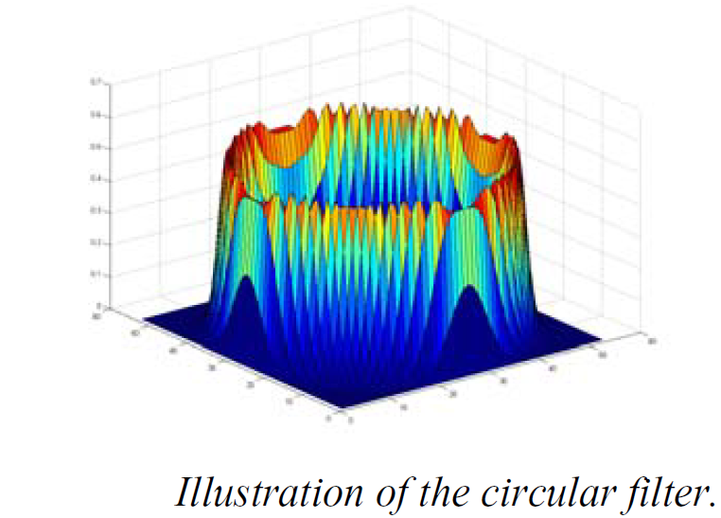
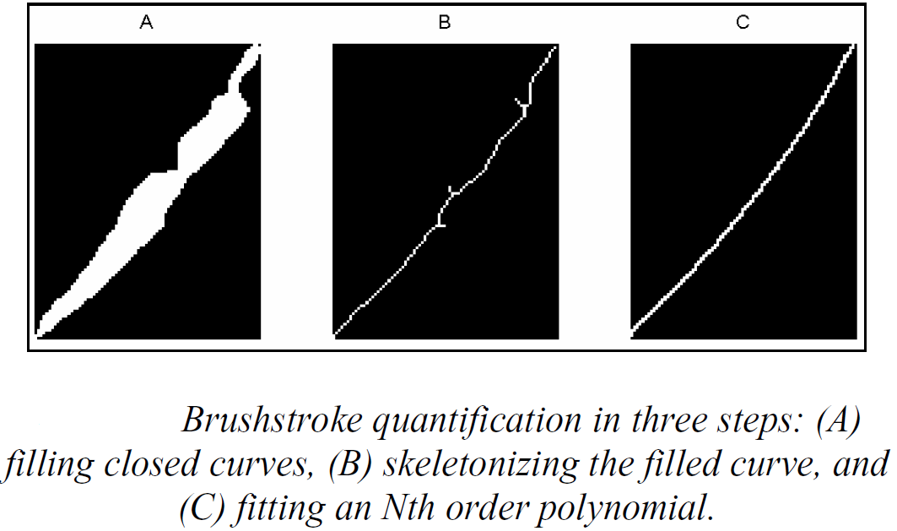
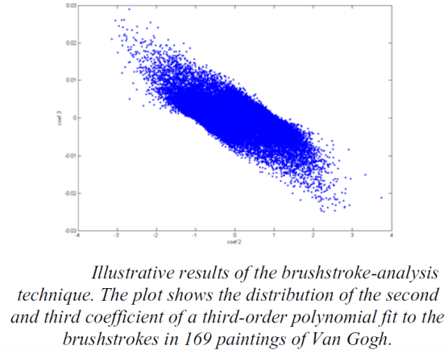
Some Works
Berezhnoy et al. (2005), in “Authentic: Computerized brushstroke analysis”, made analysis of the visual texture of the paintings of van Gogh and conclude that the use of advanced digital analysis techniques will change the way in which the authentication of visual art is currently performed. The statistical properties analyzed was visual contours, i.e., transitions in intensity along a contour. The digital extraction of brushstrokes proceeds in two steps: (I) contour enhancement, and (II) quantification of brushstroke shape.
“From Digital Imaging to Computer Image Analysis of Fine Art” (Stork) − 2010
  Outlines some general problem areas and opportunities in this new inter-disciplinary research program

Slide 9
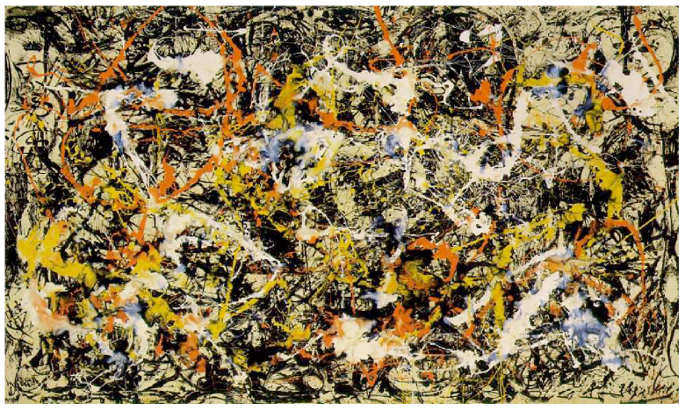
Some Works
“Discovering the Visual Signature of Painters” (van den Herik & Postma) − 2000
  Image classification to preprocessing of visual data to improve the performances of neural networks and other learning algorithms
  Combining domain knowledge with neural-network techniques
“Learning-based authentication of Jackson Pollock’s paintings” (Stork) − 2009
  Fractal analysis –much work must be done before provide robust assistance to art scholars
  A classifier trained to use all features (fractal information, Levy dimension, genus, and two features based on oriented energy) yields 81.0% accuracy

Slide 10
Some Works
“Stylistic analysis of paintings using wavelets and machine learning” (Jafarpour et al.) − 2009
  A stylistic analysis of van Gogh’s paintings: Wavelet transforms successfully capture local differences at different scales of images
  Appropriate color representation can capture local and global color saturation
  Stochastic analysis, often assuming Markov conditions, allow extraction of key features of images from the observed wavelet coefficients, despite the noise, and provide robustness
  Pattern recognition tools provide a variety of different computation classifiers capable of categorizing images based on the extracted features
“Art Authentication from an Inverse Problems Perspective” (Sloggett & Anderssen) − 2013
  The overall goal is to confirm whether a particular piece of art is what it is claimed or thought to be - connection between art authentication and inverse problems concentrating on stylometry

Slide 11
Motivation
Mathematical analysis of a painting’s digital representation could assist the art expert
Painting analysis
Artist identification
Necessary data for research has not been made widely available
Brushstroke Analysis
  Artist’s “handwriting” in the brushwork
  Individual perception
  Viewing conditions
  Knowledge of the picture’s materials
  State of preservation
  Painter’s common working methods

Slide 12
Some Works
“A digital technique for art authentication” (Lyu et al.) − 2004
  Computational technique for authenticating works of art, specifically paintings and drawings, from high-resolution digital scans
“Image Processing for Artist Identification” (Johnson et al.) − 2008
  Pennsylvania State University
    Similarity assessment via texture and brushstroke geometry modeling
  Princeton University
    Characterizing scales at which telling details emerge
  Maastricht University
    Biologically inspired painting analysis
“Rhythmic Brushstrokes Distinguish van Gogh from His Contemporaries: Findings via Automated Brushstroke Extraction” (Li et al.) − 2012
  Compare van Gogh with his contemporaries by statistically analyzing a massive set of automatically extracted brushstrokes

Slide 13
Some Works
“A digital technique for art authentication” (Lyu et al.) − 2004
  Computational technique for authenticating works of art, specifically paintings and drawings, from high-resolution digital scans
“Image Processing for Artist Identification” (Johnson et al.) − 2008
  Pennsylvania State University
    Similarity assessment via texture and brushstroke geometry modeling
  Princeton University
    Characterizing scales at which telling details emerge
  Maastricht University
    Biologically inspired painting analysis
“Rhythmic Brushstrokes Distinguish van Gogh from His Contemporaries: Findings via Automated Brushstroke Extraction” (Li et al.) − 2012
  Compare van Gogh with his contemporaries by statistically analyzing a massive set of automatically extracted brushstrokes

Slide 14
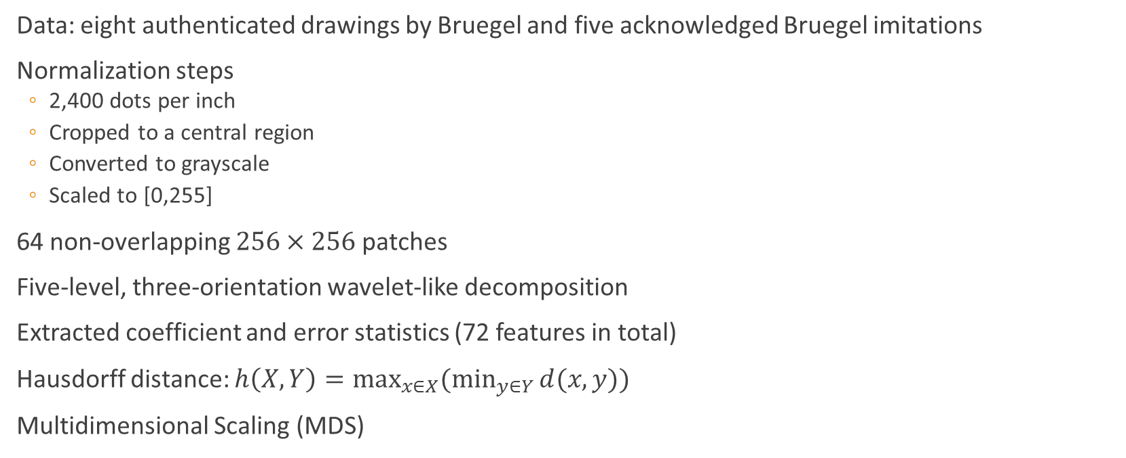
Digital Technique
Data: eight authenticated drawings by Bruegel and five acknowledged Bruegel imitations
Normalization steps
  2,400 dots per inch
  Cropped to a central region
  Converted to grayscale
  Scaled to [0,255]
64 non-overlapping $256×256$ patches
Five-level, three-orientation wavelet-like decomposition
Extracted coefficient and error statistics (72 features in total)
Hausdorff distance: $h\left(X,Y\right)=\max_{x∈X}{(\min_{y∈Y}{d(x,y)})}$
Multidimensional Scaling (MDS)

Slide 15
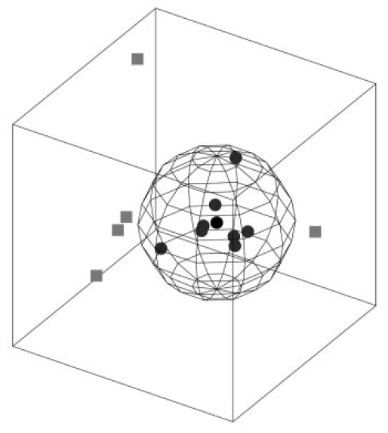
Digital Technique

Slide 16
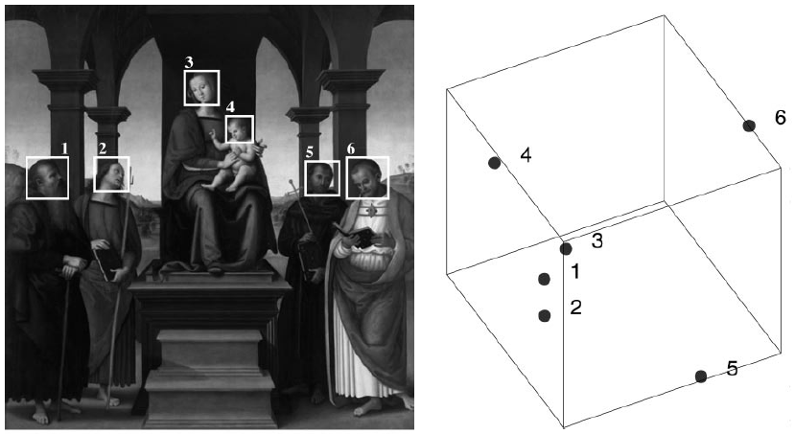
Digital Technique

Slide 17
Some Works
“A digital technique for art authentication” (Lyu et al.) − 2004
  Computational technique for authenticating works of art, specifically paintings and drawings, from high-resolution digital scans
“Image Processing for Artist Identification” (Johnson et al.) − 2008
  Pennsylvania State University
    Similarity assessment via texture and brushstroke geometry modeling
  Princeton University
    Characterizing scales at which telling details emerge
  Maastricht University
    Biologically inspired painting analysis
“Rhythmic Brushstrokes Distinguish van Gogh from His Contemporaries: Findings via Automated Brushstroke Extraction” (Li et al.) − 2012
  Compare van Gogh with his contemporaries by statistically analyzing a massive set of automatically extracted brushstrokes

Slide 18
Data
Van Gogh and Kröller-Müller Museums
High resolution gray-scale scans of existing Ektachrome films
Scaled (via bi-cubic resampling) to a uniform density of 196.3 dots per painted-inch
Digitized to 16 b/channel
101 paintings
  82 attributed to van Gogh
  6 known to be non-van Gogh
  13 questioned by experts

Slide 19
Penn State
Pennsylvania State University
Similarity assessment via texture and brushstroke geometry modeling
23 works that are unquestionably by van Gogh and that represent different periods of his art life and different painting techniques
Low average distance indicates a measure of stylistic proximity

Slide 20
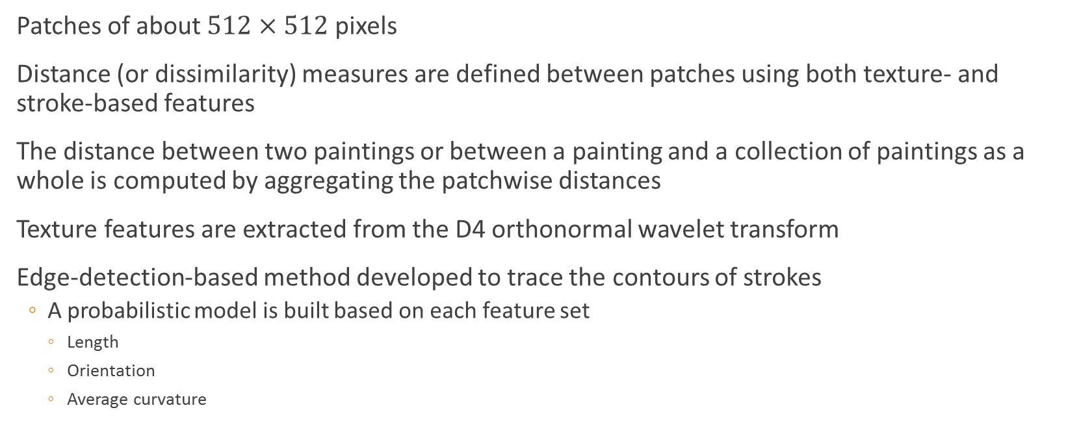
Penn State
Patches of about $512×512$ pixels
Distance (or dissimilarity) measures are defined between patches using both texture- and stroke-based features
The distance between two paintings or between a painting and a collection of paintings as a whole is computed by aggregating the patchwise distances
Texture features are extracted from the D4 orthonormal wavelet transform
Edge-detection-based method developed to trace the contours of strokes
  A probabilistic model is built based on each feature set
    Length
    Orientation
    Average curvature

Slide 21
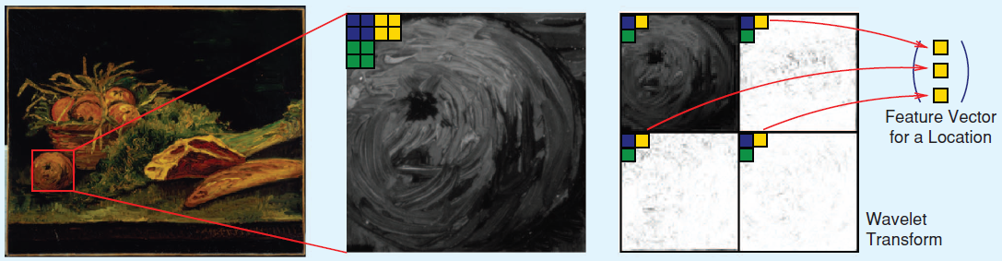
Penn State

Slide 22
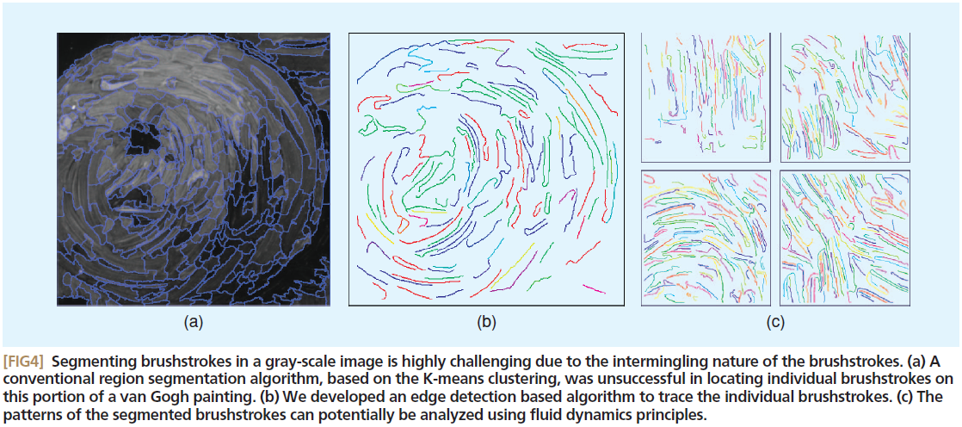
Penn State

Slide 23
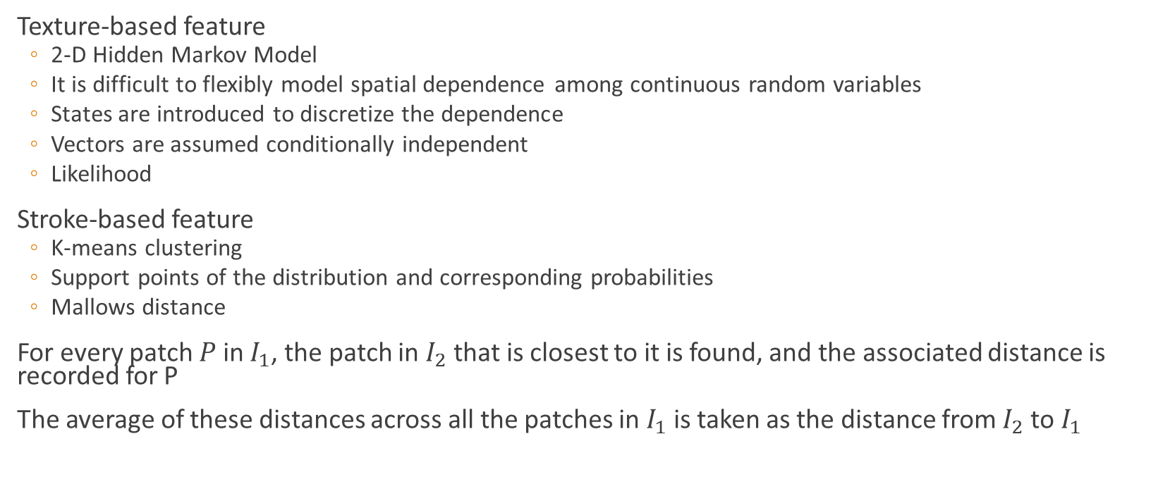
Penn State
Texture-based feature
  2-D Hidden Markov Model
  It is difficult to flexibly model spatial dependence among continuous random variables
  States are introduced to discretize the dependence
  Vectors are assumed conditionally independent
  Likelihood
Stroke-based feature
  K-means clustering
  Support points of the distribution and corresponding probabilities
  Mallows distance
For every patch $P$ in $I_{1}$, the patch in $I_{2}$ that is closest to it is found, and the associated distance is recorded for P
The average of these distances across all the patches in $I_{1}$ is taken as the distance from $I_{2}$ to $I_{1}$

Slide 24
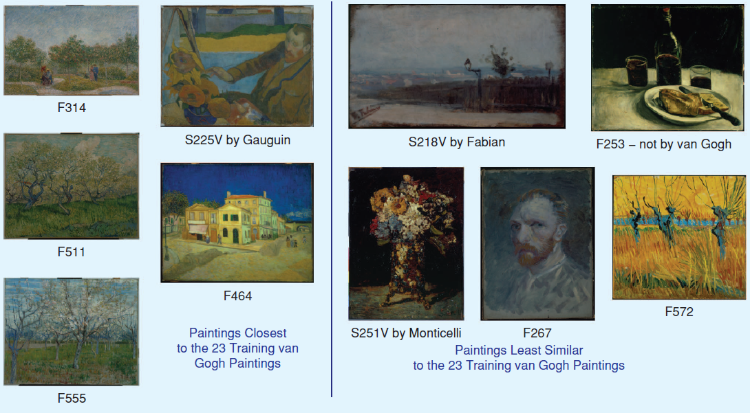
Penn State

Slide 25
Princeton
Princeton University
Characterizing scales at which telling details emerge
Hidden Markov Tree (special kind of Hidden Markov Model)
Each wavelet coefficient is associated with a hidden state (edge or nonedge)
All coefficients of scale and orientation are modeled by a zero-mean Gaussian
Transition probabilities between hidden states
  A smooth gradient between solid regions corresponds to an edge state at coarse scales and a nonedge at finer scales
Four model parameters for each coefficient pair (108 features in total)
Features are ranked and selected according to their effectiveness in distinguishing van Gogh and non-van Gogh patches
Weighted (Euclidean) distances

Slide 26
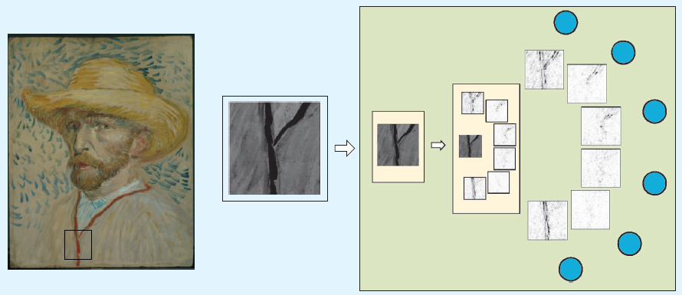
Princeton

Slide 27
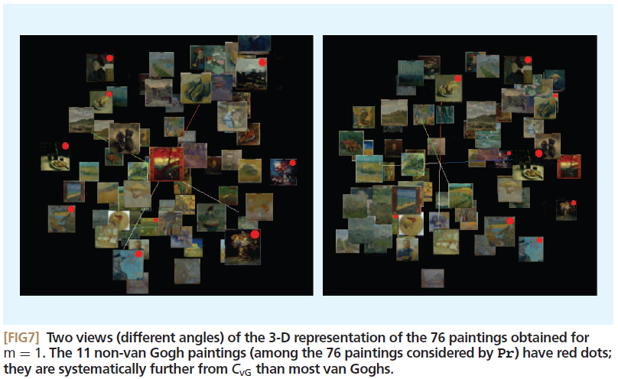
Princeton

Slide 28
Maastricht
Maastricht University
Biologically inspired painting analysis
Three principles:
  Contours are important
  Images must be analyzed at multiple scales
  Similarities between paintings are reflected in the local texture (i.e., patterns of brushstrokes)
Convolving the paintings with multiscale-oriented Gabor wavelet filters
Six orientations and four scales set to values so that the smallest and largest filters roughly match the smallest and largest brushstrokes
Histogramming the resulting coefficients

Slide 29
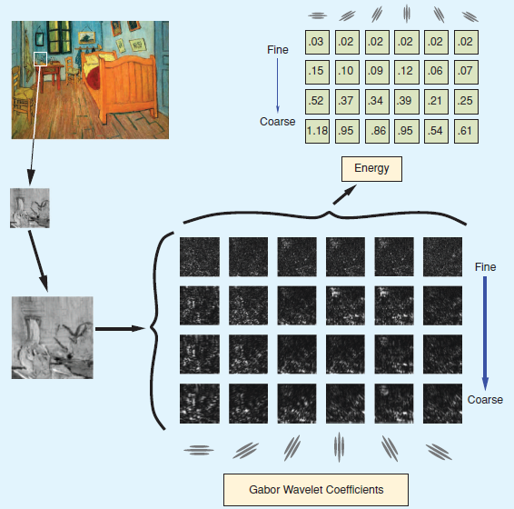
Maastricht

Slide 30
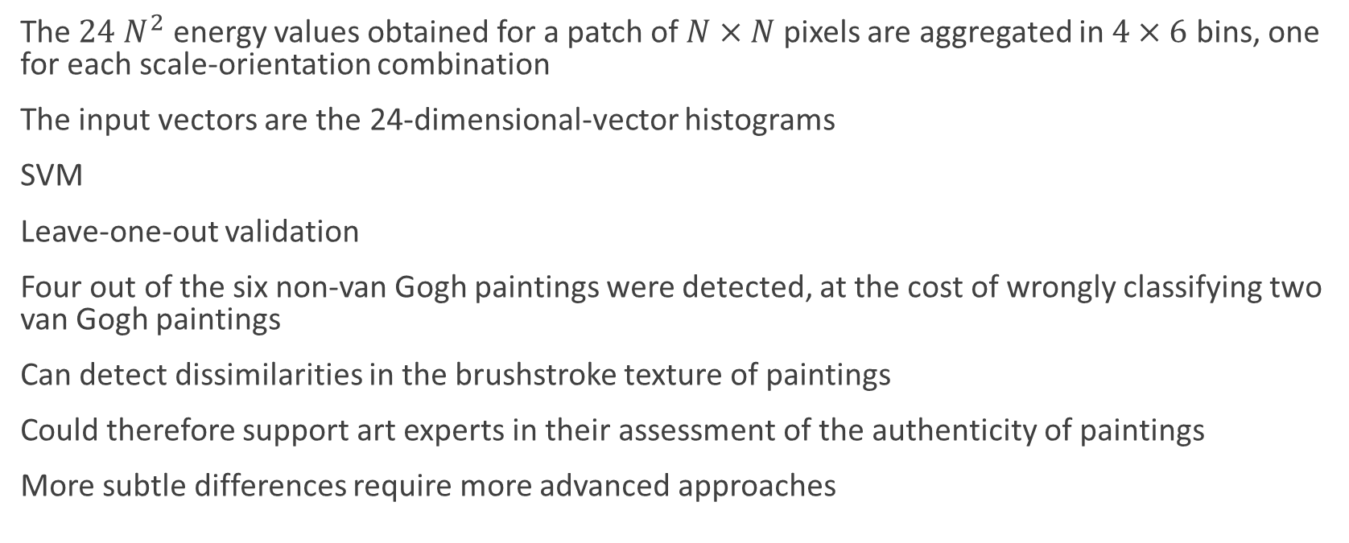
Maastricht
The $24 N^{2}$ energy values obtained for a patch of $N×N$ pixels are aggregated in $4×6$ bins, one for each scale-orientation combination
The input vectors are the 24-dimensional-vector histograms
SVM
Leave-one-out validation
Four out of the six non-van Gogh paintings were detected, at the cost of wrongly classifying two van Gogh paintings
Can detect dissimilarities in the brushstroke texture of paintings
Could therefore support art experts in their assessment of the authenticity of paintings
More subtle differences require more advanced approaches

Slide 31
Some Works
“A digital technique for art authentication” (Lyu et al.) − 2004
  Computational technique for authenticating works of art, specifically paintings and drawings, from high-resolution digital scans
“Image Processing for Artist Identification” (Johnson et al.) − 2008
  Pennsylvania State University
    Similarity assessment via texture and brushstroke geometry modeling
  Princeton University
    Characterizing scales at which telling details emerge
  Maastricht University
    Biologically inspired painting analysis
“Rhythmic Brushstrokes Distinguish van Gogh from His Contemporaries: Findings via Automated Brushstroke Extraction” (Li et al.) − 2012
  Compare van Gogh with his contemporaries by statistically analyzing a massive set of automatically extracted brushstrokes

Slide 32
Rhythmic Brushstrokes
Two challenges were designed by art historians
  Separating van Gogh from his contemporaries
    Four paintings in each group
  Divide van Gogh’s paintings by dating into two periods
    Eight paintings in each group
Evidence substantiates that van Gogh’s brushstrokes are strongly rhythmic
  Regularly shaped brushstrokes are tightly arranged, creating a repetitive and patterned impression
Traits that distinguish van Gogh’s paintings in different time periods of his development are all different from those distinguishing van Gogh from his peers

Slide 33
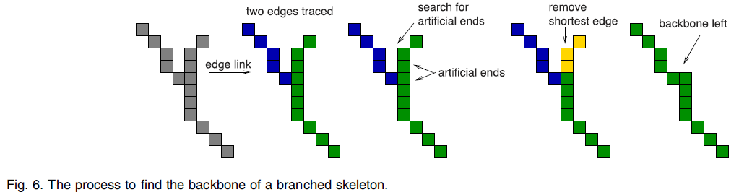
Rhythmic Brushstrokes

Slide 34
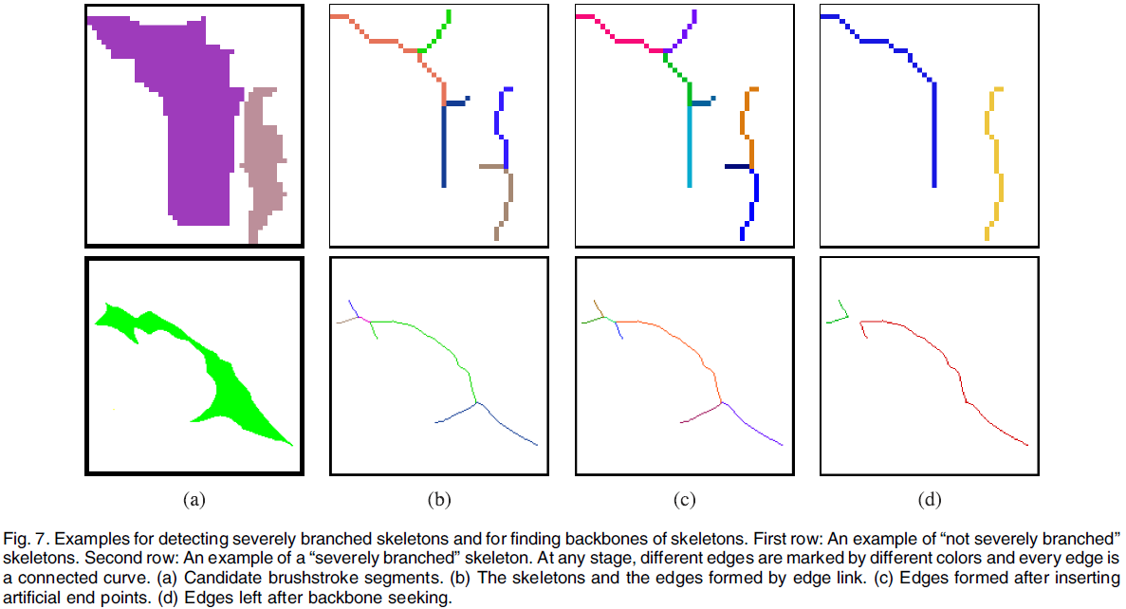
Rhythmic Brushstrokes

Slide 35
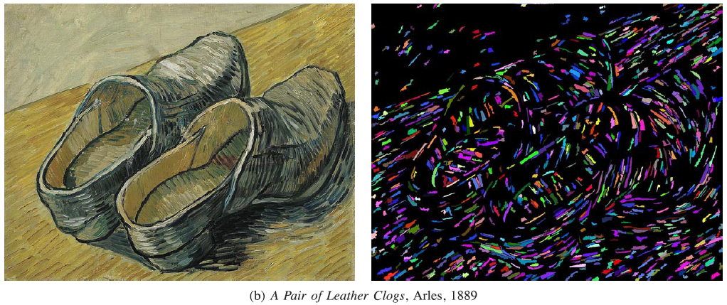
Rhythmic Brushstrokes

Slide 36
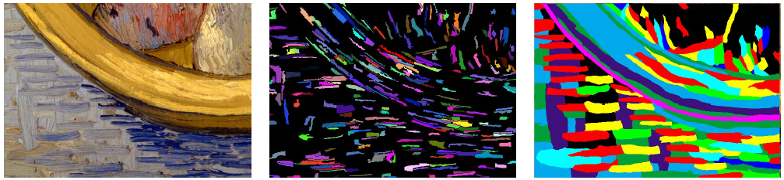
Rhythmic Brushstrokes

Slide 37
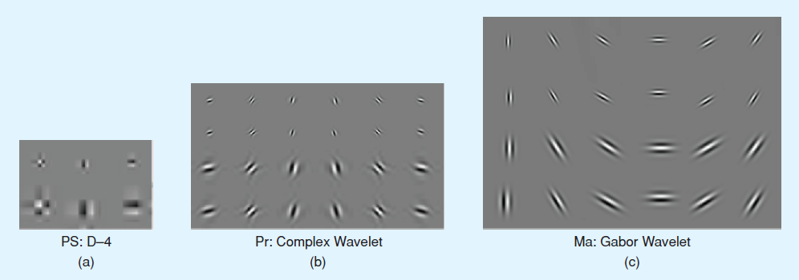
Some Works

Slide 38
Conclusion
Many studies have been done in different areas
Small databases (not widely available)
Main contributions are focused on feature extraction and some comparison methods
Many unanswered questions remain
Next steps ...

Slide 39
Our Approach
Patches
Deep Learning
OverFeat
  Feature extraction
SVM
Leave-one-out
  Same validation method for performance comparison

Slide 40
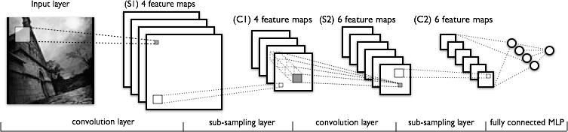
Our Approach

